Slide 1
Computer Network | OSI and TCP/IP Model to be continued ...
Andranik Barseghyan
https://github.com/Andranik93/Presentation

Slide 2
Introduction
What is The OSI Model ?
CONTENTS
TCP/IP

Slide 3
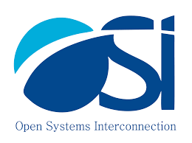





Introduction

Slide 4

OSI Model
TCP/IP
Open Systems Interconnection model (OSI model) is a conceptual model that characterizes and standardizes the communication functions of a telecommunication or computing system without regard to its underlying internal structure and technology. Its goal is the interoperability of diverse communication systems with standard communication protocols. The model partitions a communication system into abstraction layers. The original version of the model had seven layers.
Internet protocol suite is the conceptual model and set of communications protocols used in the Internet and similar computer networks. It is commonly known as TCP/IP because the foundational protocols in the suite are the Transmission Control Protocol (TCP) and the Internet Protocol (IP). It is occasionally known as the Department of Defense (DoD) model because the development of the networking method was funded by the United States Department of Defense through DARPA.

Slide 5
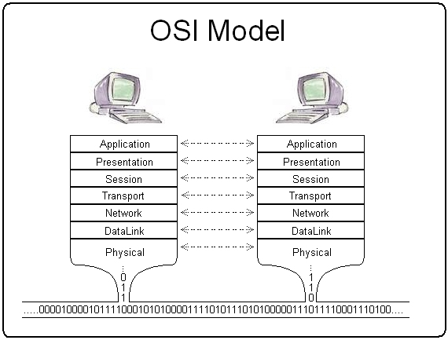
What is The OSI Model ?
A layer serves the layer above it and is served by the layer below it. For example, a layer that provides error-free communications across a network provides the path needed by applications above it, while it calls the next lower layer to send and receive packets that constitute the contents of that path. Two instances at the same layer are visualized as connected by a horizontal connection in that layer.

Slide 6



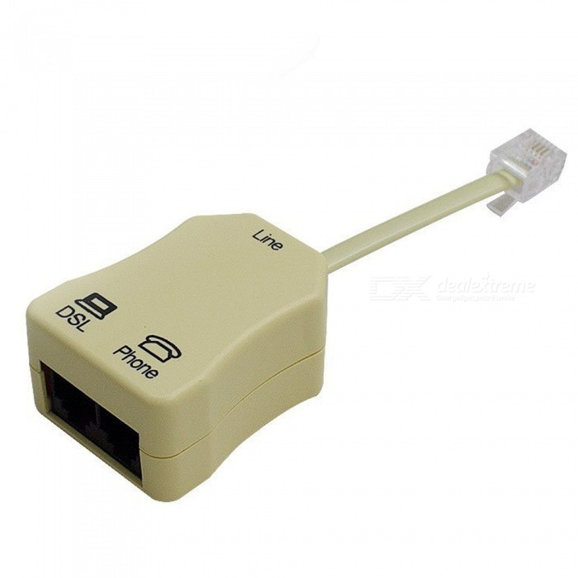
Physical Layer (L1)
The physical layer is responsible for the transmission and reception of unstructured raw data between a device and a physical transmission medium. It converts the digital bits into electrical, radio, or optical signals. Layer specifications define characteristics such as voltage levels, the timing of voltage changes, physical data rates, maximum transmission distances, modulation scheme, channel access method and physical connectors. This includes the layout of pins, voltages, line impedance, cable specifications, signal timing and frequency for wireless devices. Bit rate control is done at the physical layer and may define transmission mode as simplex, half duplex, and full duplex. The components of a physical layer can be described in terms of a network topology. Bluetooth, Ethernet, and USB all have specifications for a physical layer.
RS-232
V.34
SDH
100 BASE-TX
RJ-45
DSL
Protocol

Slide 7
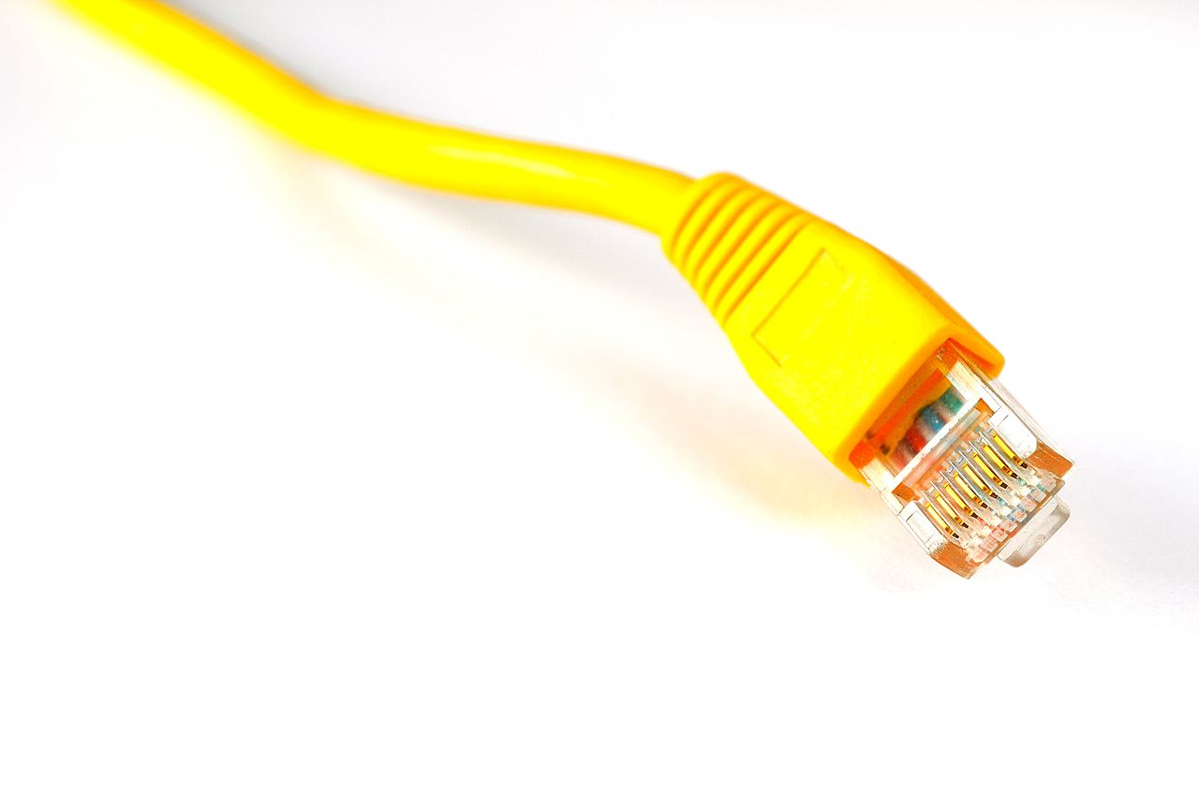
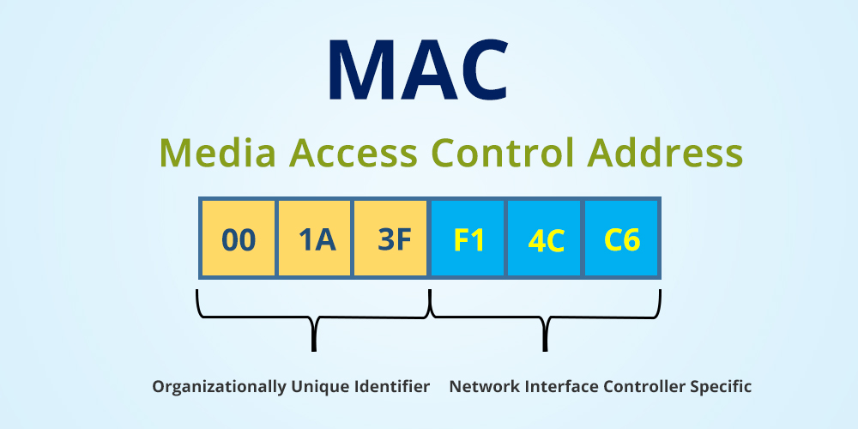
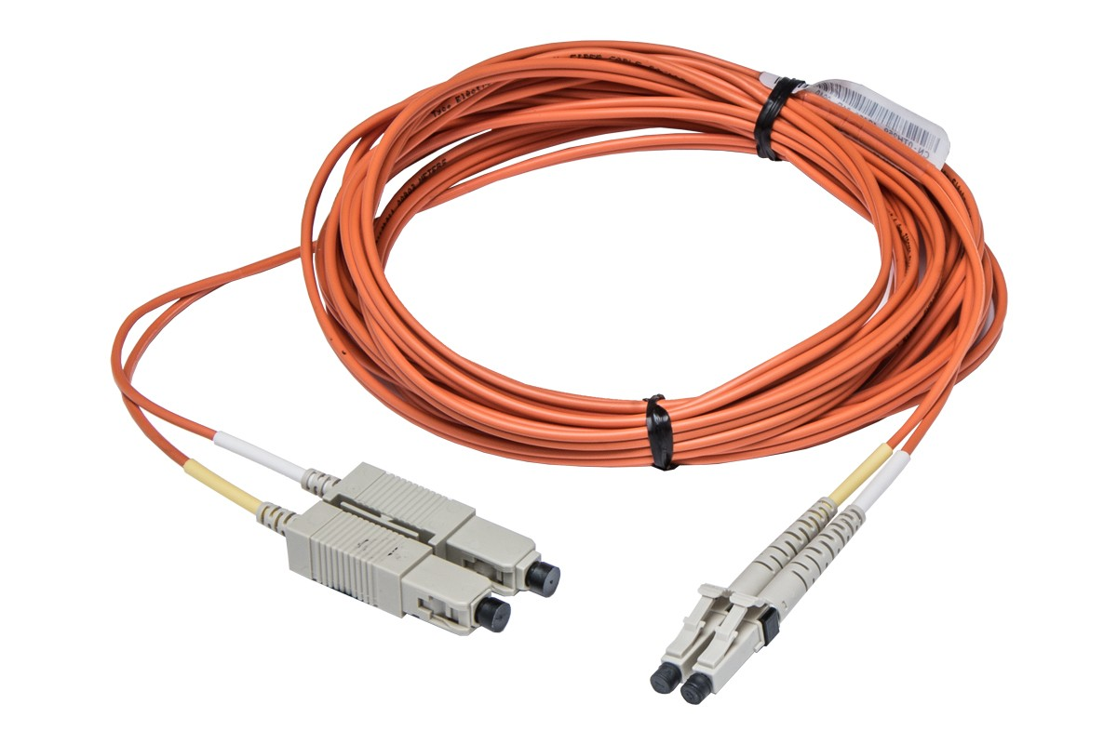
Data Link Layer (L2)
The data link layer provides node-to-node data transfer—a link between two directly connected nodes. It detects and possibly corrects errors that may occur in the physical layer. It defines the protocol to establish and terminate a connection between two physically connected devices. It also defines the protocol for flow control between them.
Medium access control (MAC) layer – responsible for controlling how devices in a network gain access to a medium and permission to transmit data.
Logical link control (LLC) layer – responsible for identifying and encapsulating network layer protocols, and controls error checking and frame synchronization.
MAC / LLC
Fibre Channel
HDP
Ethernet
VALN
ATM
HDLC
Protocol

Slide 8

Network Layer Layer (L3)
The network layer provides the functional and procedural means of transferring variable length data sequences (called packets) from one node to another connected in "different networks". A network is a medium to which many nodes can be connected, on which every node has an address and which permits nodes connected to it to transfer messages to other nodes connected to it by merely providing the content of a message and the address of the destination node and letting the network find the way to deliver the message to the destination node, possibly routing it through intermediate nodes. If the message is too large to be transmitted from one node to another on the data link layer between those nodes, the network may implement message delivery by splitting the message into several fragments at one node, sending the fragments independently, and reassembling the fragments at another node. It may, but does not need to, report delivery errors.
IPSEC
OSPF
ARP
IP
Protocol

Slide 9
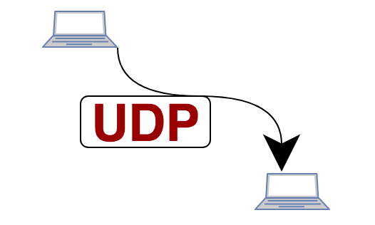

Transport Layer (L4)
The transport layer provides the functional and procedural means of transferring variable-length data sequences from a source to a destination host, while maintaining the quality of service functions.
The transport layer controls the reliability of a given link through flow control, segmentation/desegmentation, and error control. Some protocols are state- and connection-oriented. This means that the transport layer can keep track of the segments and re-transmit those that fail delivery. The transport layer also provides the acknowledgement of the successful data transmission and sends the next data if no errors occurred. The transport layer creates segments out of the message received from the application layer. Segmentation is the process of dividing a long message into smaller messages.
TCP
SCTP
SSL
UDP
TLS
Protocol

Slide 10

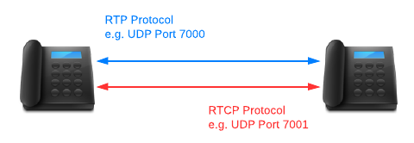
Session Layer (L5)
The session layer controls the dialogues (connections) between computers. It establishes, manages and terminates the connections between the local and remote application. It provides for full-duplex, half-duplex, or simplex operation, and establishes procedures for checkpointing, suspending, restarting, and terminating a session. In the OSI model, this layer is responsible for gracefully closing a session, which is handled in the Transmission Control Protocol at the transport layer in the Internet Protocol Suite. This layer is also responsible for session checkpointing and recovery, which is not usually used in the Internet Protocol Suite. The session layer is commonly implemented explicitly in application environments that use remote procedure calls.
RPC-Named Pipes
SIP
PPP
RTP
TCP
Protocol

Slide 11


Presentation Layer (L6)
The presentation layer establishes context between application-layer entities, in which the application-layer entities may use different syntax and semantics if the presentation service provides a mapping between them. If a mapping is available, presentation protocol data units are encapsulated into session protocol data units and passed down the protocol stack.
This layer provides independence from data representation by translating between application and network formats. The presentation layer transforms data into the form that the application accepts. This layer formats data to be sent across a network. It is sometimes called the syntax layer. The presentation layer can include compression functions. The Presentation Layer negotiates the Transfer Syntax.
DOC
AVI
MP3
HTML
JPEG
Sockets
Protocol

Slide 12


Application Layer (L7)
The application layer is the OSI layer closest to the end user, which means both the OSI application layer and the user interact directly with the software application. This layer interacts with software applications that implement a communicating component. Such application programs fall outside the scope of the OSI model. Application-layer functions typically include identifying communication partners, determining resource availability, and synchronizing communication. When identifying communication partners, the application layer determines the identity and availability of communication partners for an application with data to transmit.
HTTP / HTTPS
P2P
EMAIL / POP
Telnet
FTP
SMTP
Protocol

Slide 13
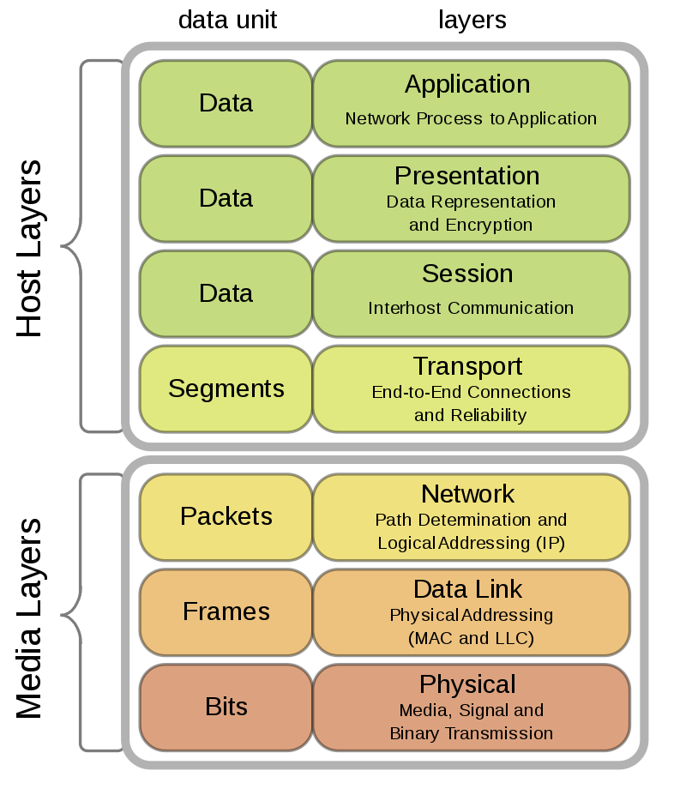
Protocol Stack

Slide 14
TCP / IP
The Internet protocol suite is the conceptual model and set of communications protocols used in the Internet and similar computer networks. It is commonly known as TCP/IP because the foundational protocols in the suite are the Transmission Control Protocol (TCP) and the Internet Protocol (IP). It is occasionally known as the Department of Defense (DoD) model because the development of the networking method was funded by the United States Department of Defense through DARPA.
The Internet protocol suite provides end-to-end data communication specifying how data should be packetized, addressed, transmitted, routed, and received. This functionality is organized into four abstraction layers, which classify all related protocols according to the scope of networking involved. From lowest to highest, the layers are the link layer, containing communication methods for data that remains within a single network segment (link); the internet layer, providing internetworking between independent networks; the transport layer, handling host-to-host communication; and the application layer, providing process-to-process data exchange for applications.
The technical standards underlying the Internet protocol suite and its constituent protocols are maintained by the Internet Engineering Task Force (IETF). The Internet protocol suite predates the OSI model, a more comprehensive reference framework for general networking systems.

Slide 15
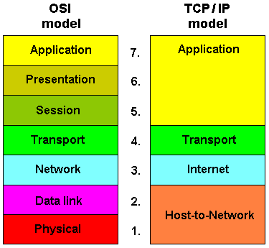
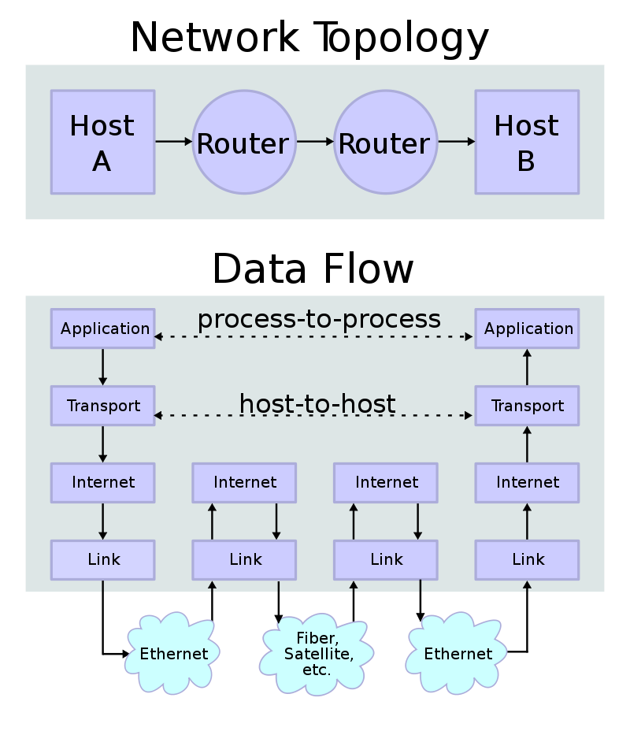

Slide 16
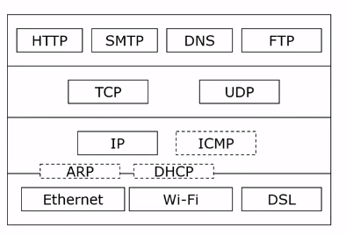
Conclusion
OSI
Theory․
Protocol not used․
TCP / IP
Protocol Widely used.
Limited model․
Usage
OSI - Describes different networks՝ Fiber Channel, Infiniband, SS7.
TCP / IP - Protocol, basic Internet.

Slide 17
Thank you
to be continued ...

